Slide 1

Supervised learning (classification)

Slide 2
Contents
Introduction to Classification
Types of Classification Models
Classification Algorithms
K-Nearest Neighbour classifier
Logistic Regression
Handling Data Imbalance in Classification

Slide 3

Question $1$
What is difference between supervised learning and unsupervised learning?

Slide 4
Question 2
What is the difference between the classification and regression (function approximation) problems in Machine Learning?

Slide 5
Introduction to Classification

Slide 6
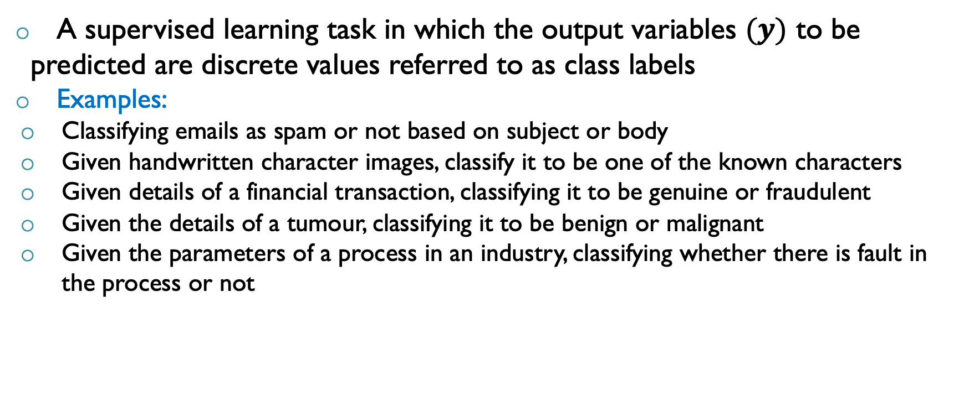
Classification
A supervised learning task in which the output variables $(y)$ to be predicted are discrete values referred to as class labels
Examples:
Classifying emails as spam or not based on subject or body
Given handwritten character images, classify it to be one of the known characters
Given details of a financial transaction, classifying it to be genuine or fraudulent
Given the details of a tumour, classifying it to be benign or malignant
Given the parameters of a process in an industry, classifying whether there is fault in the process or not

Slide 7
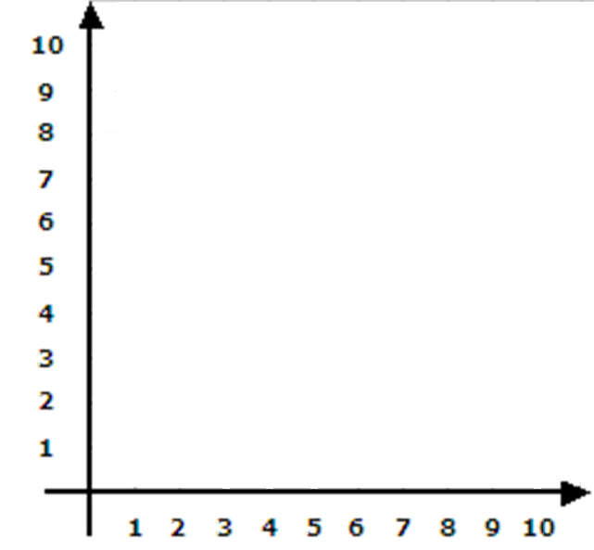


Classification: Feature Space Perspective
$$x_{2}$$
A classifier divides the feature space into a set of regions each having a class label associated with it
Boundaries between these regions can be straight, curved, smooth or rough depending on the prediction function
Referred to as decision boundaries
Region 1
Decision
Boundary
Region 2
$$x_{1}$$

Slide 8
Classification: Feature Space Perspective
$$x_{2}$$
A classifier divides the feature space into a set of regions each having a class label associated with it
Boundaries between these regions can be straight, curved, smooth or rough depending on the prediction function
Referred to as decision boundaries
Class predictions will be based on the region in which the new input lies
Region 1
Region 2
$$x_{1}$$

Slide 9
Types of Classification Models

Slide 10
Types of Classification Models
Classification models
Nature of decision boundary
Linear
Non-linear
Number of classes
Binary Classification (2 classes)
Multi-class classification (more than 2 classes)
Number of Targets per input
Multi-label classification

Slide 11
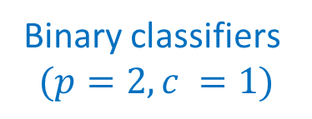
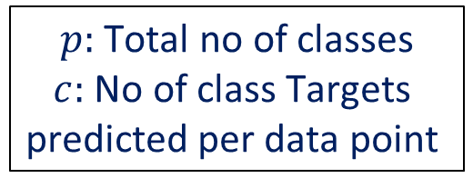
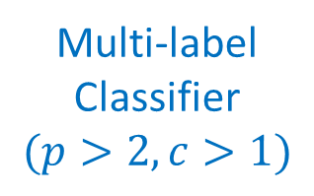
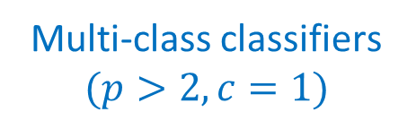
Types of Classification Models
Multi-class classifiers
$$(p>2, c=1)$$
Binary classifiers
$$(p=2, c =1)$$
Linear classifiers
Multi-label
Classifier
$$(p>2, c>1)$$
Linear classifiers
Non-linear classifiers
$p:$ Total no of classes
$c:$ No of class Targets
predicted per data point
Non-linear classifiers

Slide 12
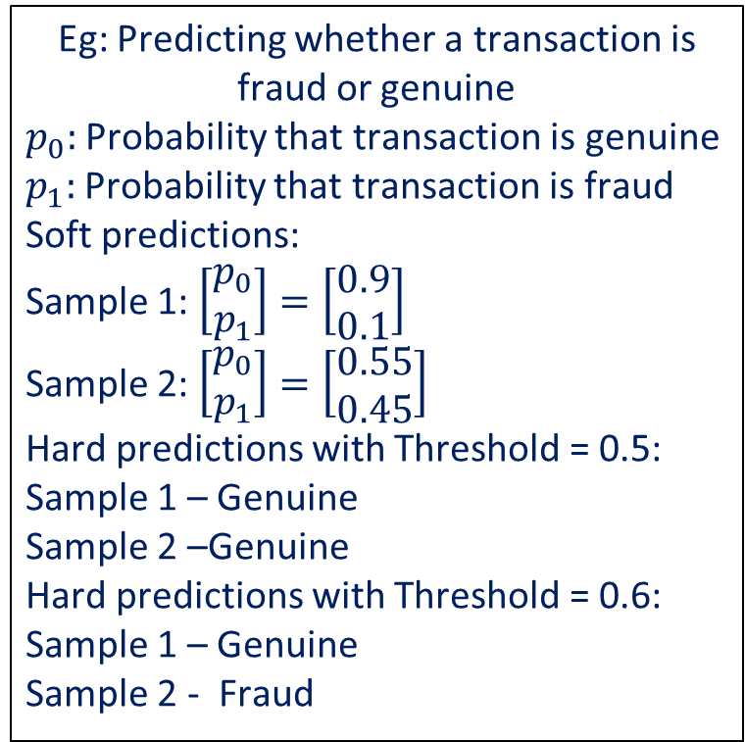
Soft vs Hard Predictions in Classification
Soft Prediction: Classifier predicts the probability of a data point belonging to a each of the target classes
Hard Prediction: Classifier predicts the class that the data point might belong to
Soft prediction gives more information on the confidence of the classifier in the prediction made
Soft prediction can be turned into a hard prediction by setting a probability threshold
Eg: Predicting whether a transaction is fraud or genuine
$p_{0}:$ Probability that transaction is genuine
$p_{1}:$ Probability that transaction is fraud
Soft predictions:
Sample 1: $\left[\begin{matrix}p_{0} \\ p_{1}\end{matrix}\right]=\left[\begin{matrix}0.9 \\ 0.1\end{matrix}\right]$
Sample 2: $\left[\begin{matrix}p_{0} \\ p_{1}\end{matrix}\right]=\left[\begin{matrix}0.55 \\ 0.45\end{matrix}\right]$
Hard predictions with Threshold = 0.5: Sample 1 – Genuine
Sample 2 –Genuine
Hard predictions with Threshold = 0.6: Sample 1 – Genuine
Sample 2 - Fraud

Slide 13
Classification Algorithms

Slide 14
Classification Algorithms
Linear Separable classes
$$x_{2}$$
Algorithms for Linear Classifiers:
Logistic Regression – Soft predictions
Linear Discriminant Classifier – soft predictions
Naive Bayes – soft predictions
Support Vector Machine (Linear Kernel) – Hard predictions
Linear classifiers perform best when the classes are linearly separable or close to linearly separable
Algorithms for Non-Linear Classifiers:
K-Nearest Neighbours – Hard predictions
Neural Networks (Multi-Layer Perceptron) – Soft predictions
SVM (Non-linear kernels) – Hard predictions
Decision Trees, Random Forest and Boosting – soft predictions
Decision
Boundary
$$x_{1}$$

Slide 15
Classification Algorithms
Not Linear Separable
$$x_{2}$$
Algorithms for Linear Classifiers:
Logistic Regression – Soft predictions
Linear Discriminant Classifier – soft predictions
Naive Bayes – soft predictions
Support Vector Machine (Linear Kernel) – Hard predictions
Linear classifiers perform best when the classes are linearly separable or close to linearly separable
Algorithms for Non-Linear Classifiers:
K-Nearest Neighbours – Hard predictions
Neural Networks (Multi-Layer Perceptron) – Soft predictions
SVM (Non-linear kernels) – Hard predictions
Decision Trees, Random Forest and Boosting – soft predictions
$$x_{1}$$

Slide 16
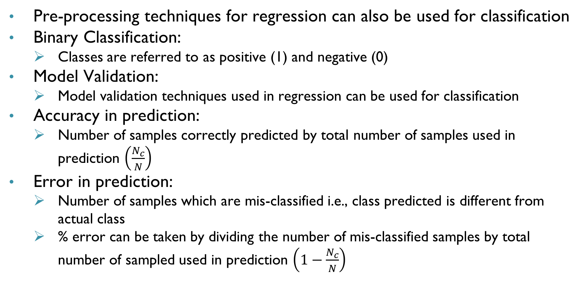
Some Points to Note
Pre-processing techniques for regression can also be used for classification
Binary Classification:
Classes are referred to as positive (1) and negative (0)
Model Validation:
Model validation techniques used in regression can be used for classification
Accuracy in prediction:
Number of samples correctly predicted by total number of samples used in prediction $\left(\frac{N_{c}}{N}\right)$
Error in prediction:
Number of samples which are mis-classified i.e., class predicted is different from actual class
% error can be taken by dividing the number of mis-classified samples by total number of sampled used in prediction $\left(1−\frac{N_{c}}{N}\right)$

Slide 17
K-Nearest Neighbour Classifier

Slide 18
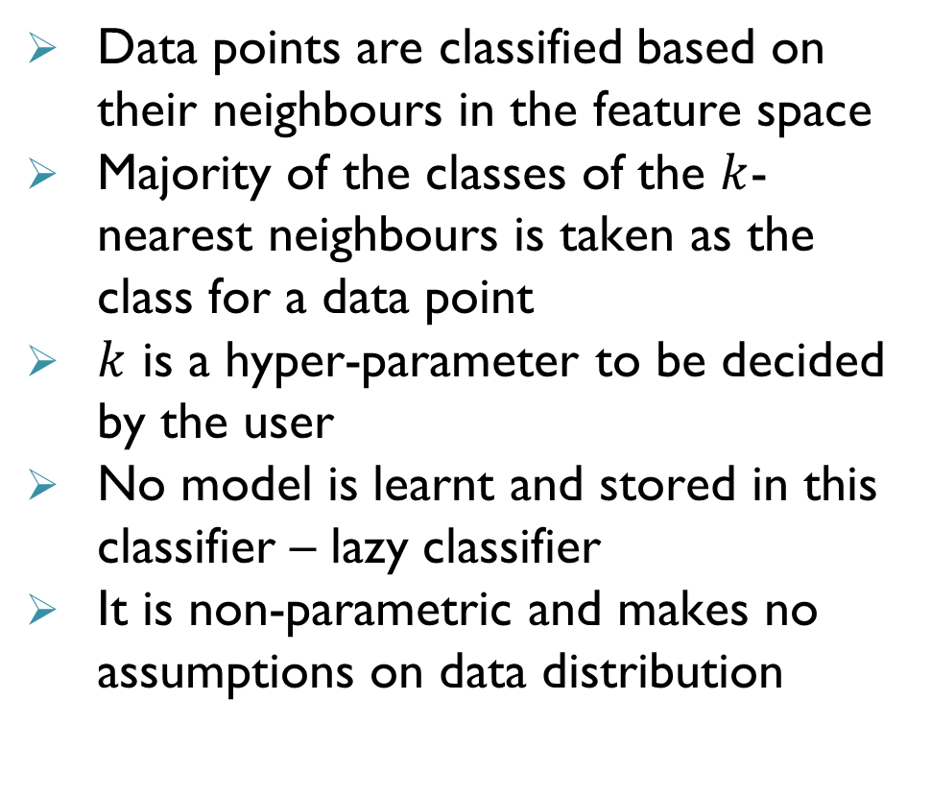

k-Nearest Neighbour (kNN) Classifier
$$x_{2}$$
Data points are classified based on their neighbours in the feature space
Majority of the classes of the $k$-nearest neighbours is taken as the class for a data point
$k$ is a hyper-parameter to be decided by the user
No model is learnt and stored in this classifier – lazy classifier
It is non-parametric and makes no assumptions on data distribution
1
$$k=4$$
1
1
1
1
1
1
1
1
1
1
1
1
1
1
1
1
1
1
1
1
1
1
0
0
0
1
0
0
0
0
0
0
0
0
0
0
0
0
0
0
$$x_{1}$$
0
0
0
0

Slide 19
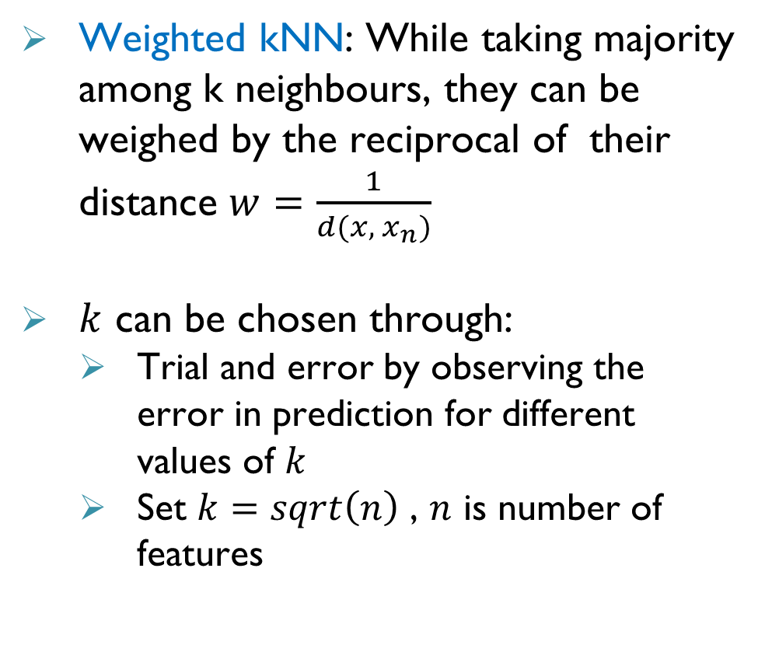
k-Nearest Neighbour (kNN) Classifier
$$x_{2}$$
Weighted kNN: While taking majority among k neighbours, they can be weighed by the reciprocal of their distance $w=\frac{1}{d(x,{ x}_{n})}$
$k$ can be chosen through:
Trial and error by observing the error in prediction for different values of $k$
Set $k=sqrt\left(n\right)$ , $n$ is number of features
1
$$k=4$$
1
1
1
1
1
1
1
1
1
1
1
1
1
1
1
1
1
1
1
1
1
1
0
0
0
1
0
0
0
0
0
0
0
0
0
0
0
0
0
$$x_{1}$$
0
0
0

Slide 20
Logistic Regression

Slide 21
Logistic regression
Logistic regression is a classification technique
Decision boundary (generally linear) is derived based on probability interpretation
Results in a nonlinear optimization problem for parameter estimation
Goal: Given a new data point, predict the class from which the data point is likely to have originated

Slide 22
Binary classification problem
Classification is the task
of identifying a category that a new observation belongs to based on the data with known categories
When the number of categories is 2,
it becomes a binary classification problem
Binary classification is a simple “Yes” or “No” problem

Slide 23

Input features
Input features can be both qualitative and quantitative
If the inputs are qualitative, then there has to be a systematic way of converting them to quantities
For example: A binary input like a “Yes” or “No” can be encoded as “$1$” and “0”
Some data analytics approach can handle qualitative variables directly

Slide 24
Linear classifier
Decision function is linear
Binary classification can be performed depending on the side of the half-plane that the data falls in
However, simply guessing “yes” or “no” is pretty crude
Can we do something better using probabilities ?

Slide 25
Output
Why model probabilities ?
The probability of a “Yes” or “No” gives a better understanding of the sample’s membership to a particular category
Estimating the binary outputs from the probabilities is straight forward through simple thresholding
How does one model this probability ?

Slide 26
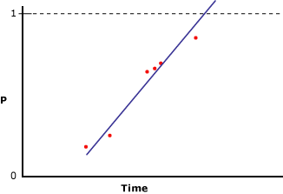
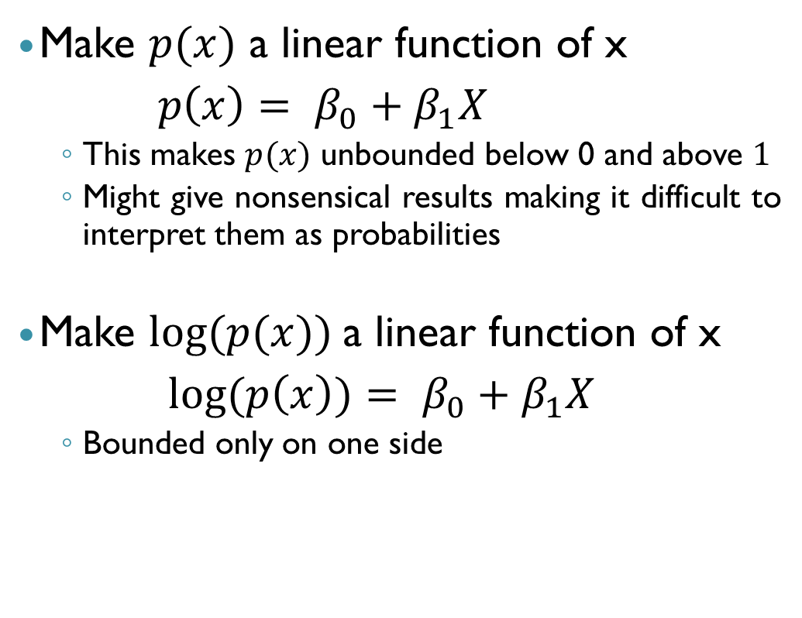
Linear and log models
Make $p(x)$ a linear function of x
$p\left(x\right)= β_{0}+β_{1}X$
This makes $p(x)$ unbounded below 0 and above $1$
Might give nonsensical results making it difficult to interpret them as probabilities
Make $log⁡(p(x))$a linear function of x
$log(p\left(x\right))= β_{0}+β_{1}X$
Bounded only on one side

Slide 27
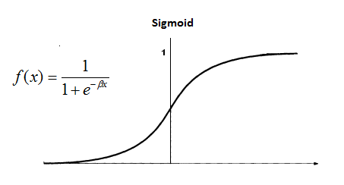
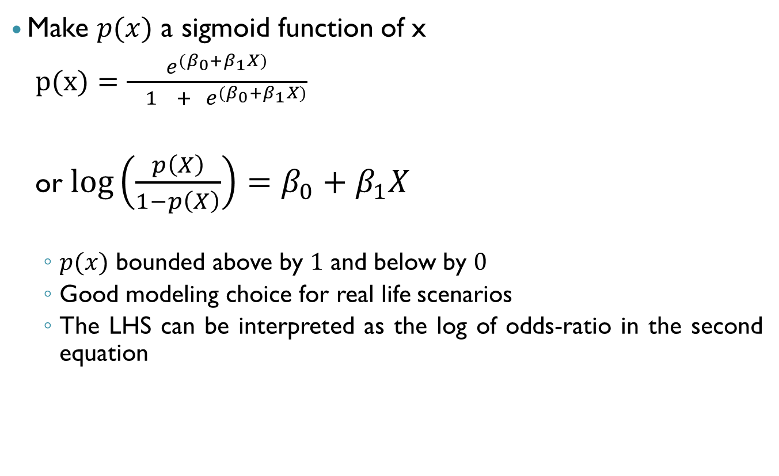
Sigmoid function
Make $p(x)$ a sigmoid function of x
$p(x)=\frac{e^{{(β}_{0}+β_{1}X)}}{ 1 + { e}^{{(β}_{0}+β_{1}X)}}$
or$\log\left(\frac{p\left(X\right)}{1−p\left(X\right)}\right)=β_{0}+β_{1}X$
$p(x)$ bounded above by $1$ and below by $0$
Good modeling choice for real life scenarios
The LHS can be interpreted as the log of odds-ratio in the second equation

Slide 28
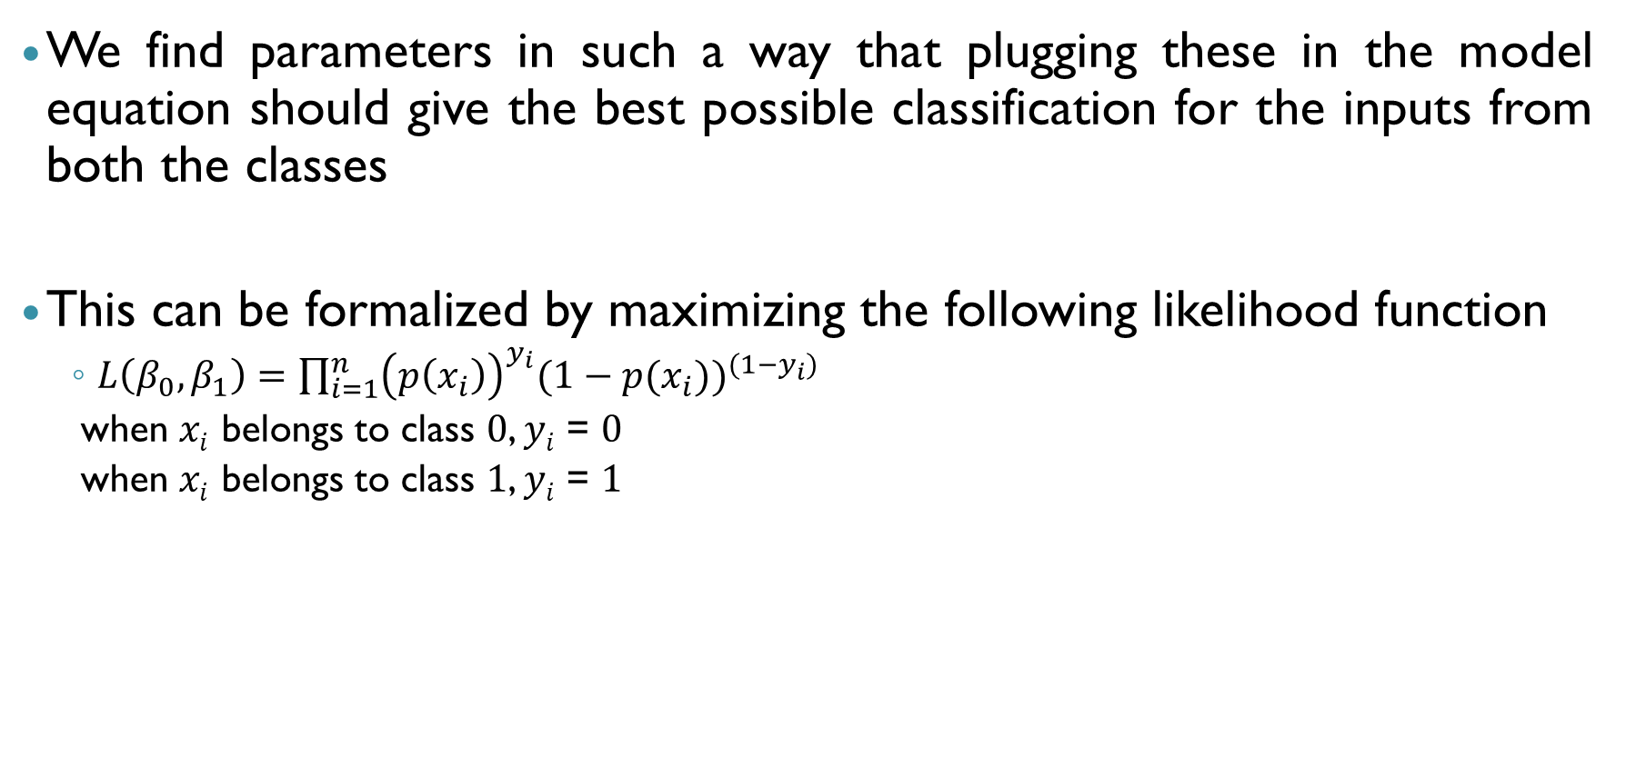
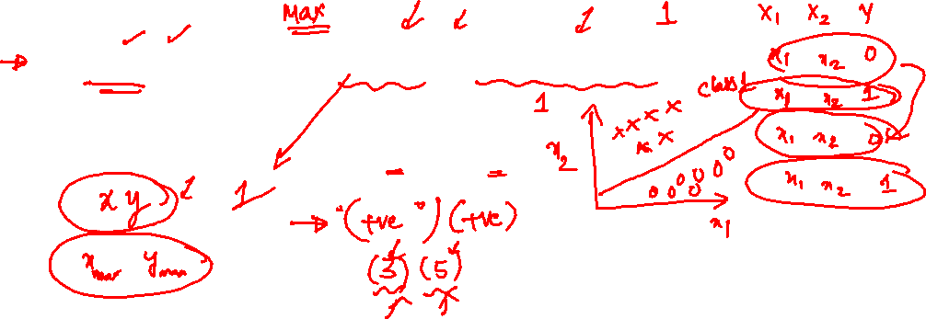
Estimation of the parameters
We find parameters in such a way that plugging these in the model equation should give the best possible classification for the inputs from both the classes
This can be formalized by maximizing the following likelihood function
$L\left(β_{0},β_{1}\right)=\prod_{i=1}^{n}{{\left(p\left(x_{i}\right)\right)}^{y_{i}}{(1−p(x_{i}))}^{(1−y_{i})}}$
when $xi$ belongs to class $0$, $yi$ = $0$
when $xi$ belongs to class $1$, $yi$ = $1$

Slide 29
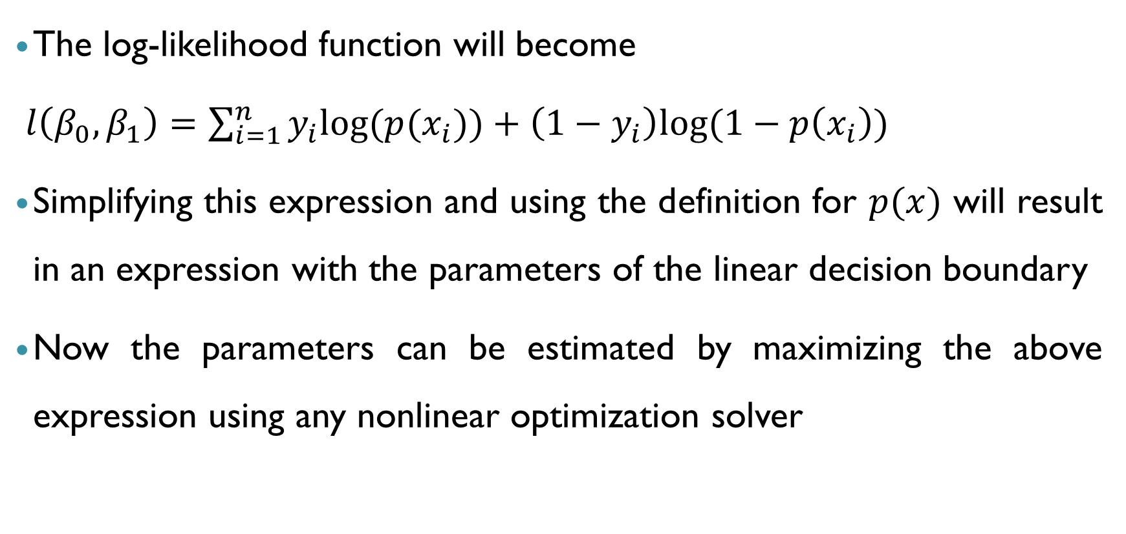
Log-likelihood function
The log-likelihood function will become
$l\left(β_{0},β_{1}\right)=\sum_{i=1}^{n}{y_{i}log⁡(p(x_{i}))}+\left(1−y_{i}\right)log⁡(1−p\left(x_{i}\right))$
Simplifying this expression and using the definition for $p(x)$ will result in an expression with the parameters of the linear decision boundary
Now the parameters can be estimated by maximizing the above expression using any nonlinear optimization solver

Slide 30
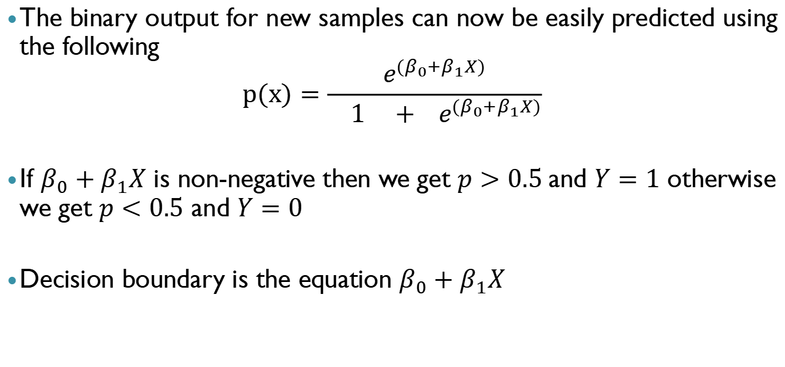
Logit model
The binary output for new samples can now be easily predicted using the following
$$p(x)=\frac{e^{{(β}_{0}+β_{1}X)}}{ 1 + { e}^{{(β}_{0}+β_{1}X)}}$$
If $β_{0}+β_{1}X$ is non-negative then we get $p>0.5$and $Y=1$ otherwise we get $p<0.5$ and $Y=0$
Decision boundary is the equation $β_{0}+β_{1}X$

Slide 31

Example $1$
X₁ | X₂
1 | 1
2 | 1
3 | 1
4 | 1
5 | 1
1 | 2
2 | 2
3 | 2
4 | 2
5 | 2
X₁ | X₂
6 | 3
7 | 3
8 | 3
9 | 3
10 | 3
6 | 4
7 | 4
8 | 4
9 | 4
10 | 4
X₁ | X₂ | Class ?
1 | 3 | ?
2 | 3 | ?
4 | 4 | ?
5 | 4 | ?
3 | 3 | ?
6 | 2 | ?
9 | 2 | ?
8 | 1 | ?
7 | 2 | ?
10 | 1 | ?
Class 0
Class 1
Test Data

Slide 32
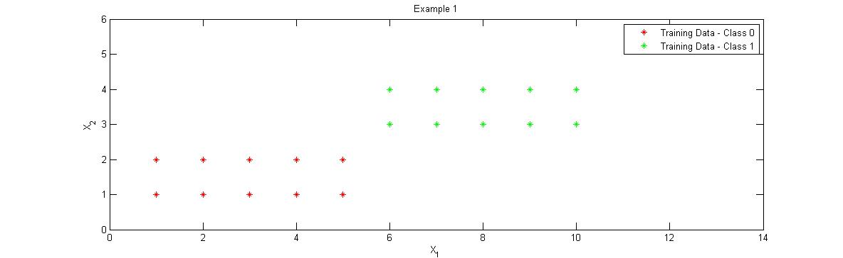

Example $1$ continued

Slide 33
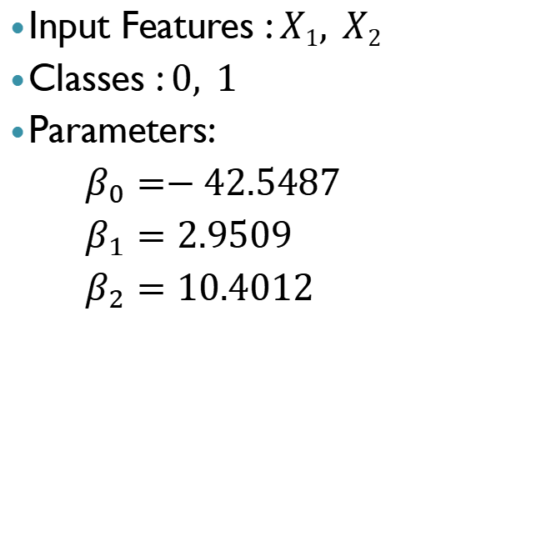
Results
Input Features : $X1, X2$
Classes : $0, 1$
Parameters:
$β_{0}=−42.5487$
$β_{1}=2.9509$
$β_{2}=10.4012$
X₁ | X₂ | Prob | Class
1 | 3 | 0.0002 | 0
2 | 3 | 0.004 | 0
4 | 4 | 0.999 | 1
5 | 4 | 0.999 | 1
3 | 3 | 0.076 | 0
6 | 2 | 0.0172 | 0
9 | 2 | 0.991 | 1
8 | 1 | 0.0002 | 0
7 | 2 | 0.251 | 0
10 | 1 | 0.0667 | 0

Slide 34
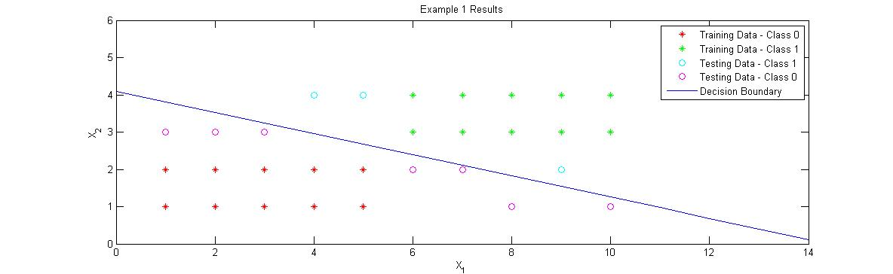


Example $1$ solution
$$2.9509X_{1}+10.4012X_{2} =42.5487$$

Slide 35
Which Classification method to use?
Basic classifiers: Logistic regression, Linear discriminant classifier, KNN based classifier, Naive Bayes classifier
Advanced Classifiers: SVM, Random forest, Boosting trees and Neural Networks
It is recommended to build some basic classifiers to understand the data better before going for advanced classifiers
Large amount of data would be required to build good models using advanced classifiers
LDA can be used as a pre-processing step to reduce dimensionality before building a classifier
Need for interpretability and continuous training also needs to be taken into considering while choosing a classification method

Slide 36
Handling Data Imbalance in Classification

Slide 37
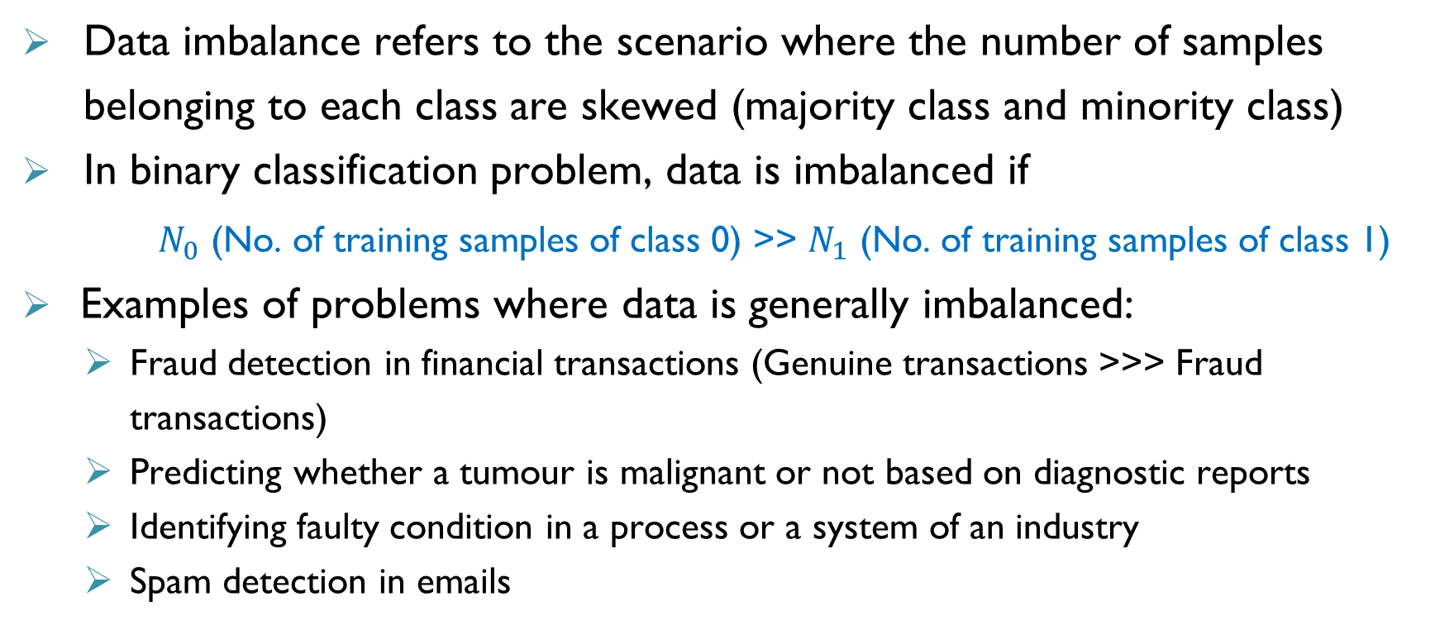
Handling Data Imbalance in Classification
Data imbalance refers to the scenario where the number of samples belonging to each class are skewed (majority class and minority class)
In binary classification problem, data is imbalanced if
$N_{0}$ (No. of training samples of class 0) >> $N_{1}$ (No. of training samples of class 1)
Examples of problems where data is generally imbalanced:
Fraud detection in financial transactions (Genuine transactions >>> Fraud transactions)
Predicting whether a tumour is malignant or not based on diagnostic reports
Identifying faulty condition in a process or a system of an industry
Spam detection in emails

Slide 38
Handling Data Imbalance in Classification
$$x_{2}$$
Data imbalance significantly affects the performance of classification model learnt
Accuracy would be high but model performance on the minority class would be very poor
Techniques such as under sampling, oversampling, synthetic sampling, weighing samples, etc. need to be used to handle data imbalance
Performance measures such as precision recall, Area under ROC curve, etc. need to be used instead of accuracy for model validation
$$x_{1}$$

Slide 39
Summary
Classifiers are build to make predictions on class labels and they divide the feature space into different regions which are assigned different classes
Classifiers can be categories into different types based on nature of decision boundary and number of classes
Different types of classifier have been developed to perform linear and non-linear classification
Logistic regression applies a sigmoid function on linear combination of inputs to predict class probabilities
Multiple classifiers need to be build to find the best classifier for the given data
If training data pertaining to different samples is skewed, then the skew needs to be corrected before building a classification model to ensure good performance

Slide 40

THANK YOU

